Slide 1
Choice of Process Models
Executing one or more activities – Process
Activities can be organized in different ways
Can be categorized into different process models
Major part of the planning will be the choosing of the development methods to be used and slotting of these into an overall process model

Slide 2
Choice of Process Models …
The Waterfall Model
Feasibility study
User requirements
Analysis
System design
Program design
Coding
Testing
Operation

Slide 3
Choice of Process Models …
The Waterfall Model (continued…)
There is a sequence of activities working top to down
Arrows pointing upwards and downwards indicates that it is necessary to go back and rework tasks that we thought has been completed.
It is similar to Waterfall which flows downwards with possibility of just a little splashing back
The project is expected to progress down the path through each of the phases of development

Slide 4
Choice of Process Models …
The Waterfall Model (continued…)
Advantage
Waterfall approach allows project completion times to be forecast with more confidence

Slide 5
Choice of Process Models …
The Waterfall Model (continued…)
Disadvantages
Customers must be able to express their requirements completely, correctly and with clarity
Delays can occur in design, coding and testing
Difficult to access the true stage of progress during the first two to three stages
No demonstration of system capabilities can occur until the end of the project

Slide 6
Choice of Process Models …
The V – process model
Feasibility study
Corrections
Review
Corrections
User requirements
User acceptance
System design
Corrections
System testing
Program design
Corrections
Program testing
code

Slide 7
Choice of Process Models …
The V – process model (continued…)
Elaboration of the waterfall model
Stresses the necessity for validation activities
Each step has matching validation process
Defects cause a loop back to the corresponding development stage and a reworking of the succeeding steps
May slip into an ‘evolutionary prototype’

Slide 8
SPIRAL MODEL
Another way of looking at waterfall model.
Greater level of detail are considered at each stage of the project
Hence greater degree of confidence about the success of the project
More details are analyzed in each sweep and an evolution process is undertaken for next iteration.

Slide 9
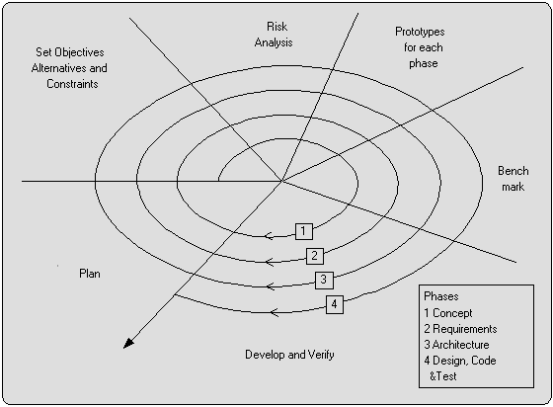
Spiral Model

Slide 10
Software Prototyping
A prototype is a working model of one or more aspects of the projected system.
In order to test assumptions it is constructed and tested quickly and inexpensively.
Classification
Throw-away prototypes
Used only to test out ideas and is then discarded.
Evolutionary prototypes
It is developed and modified until it is in a state where it can
become the operational system.
Incremental prototypes
The operational system is developed and implemented in small stages so that the feedback from earlier stages can influence later stages of project

Slide 11
Software Prototyping
Advantages
Learning by doing.
Improved communication and user involvement.
Reduced need for documentation.
Reduced maintenance costs.
Production of expected Results.
Disadvantages
Lack of control and projects standards.
Additional expense.
Close proximity of developers.

Slide 12
Software Prototyping
Other ways of categorizing prototypes
What is being learnt?
To what extent is the prototyping to be done?
What is being prototyped?

Slide 13
Software Prototyping
What is being learnt?
Helps to learn about an area of uncertainty in the project.
Specify what they hope to learn from the prototype
Plan how the prototype is to be evaluated.
Report on what has actually been learnt.
To what extent is the prototyping to be done?
Mock-ups.
Simulated interaction.
Partial working model.
Vertical: some features are prototyped fully.
Horizontal: All features are prototyped but not fully.
What is being prototyped?
Human - Computer Interface.
The Functionality of the system.

Slide 14
